Slide 1
Chapter 10 Thinking in Objects

Slide 2
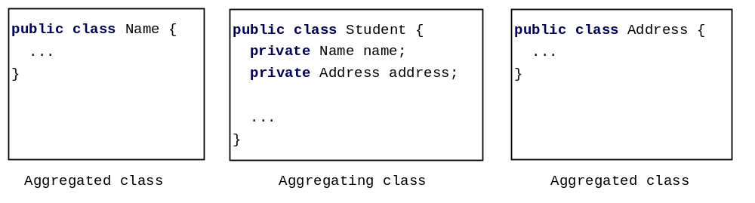
Class Representation
An aggregation relationship is usually represented as a data field in the aggregating class. For example, the relationship in Figure 10.6 can be represented as follows:

Slide 3
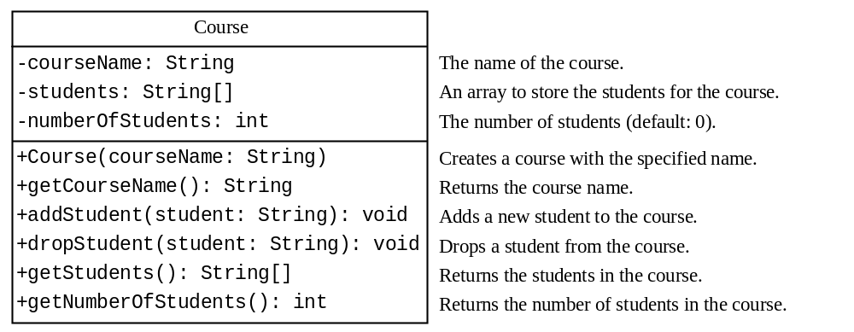
Example: The Course Class
Course
TestCourse
Run

Slide 4
Course Class
Page 378 Listing 10.5
  TestCourse.java
Page 379 Listing 10.6
  Course.java

Slide 5

Example: The StackOfIntegers Class
TestStackOfIntegers
Run

Slide 6
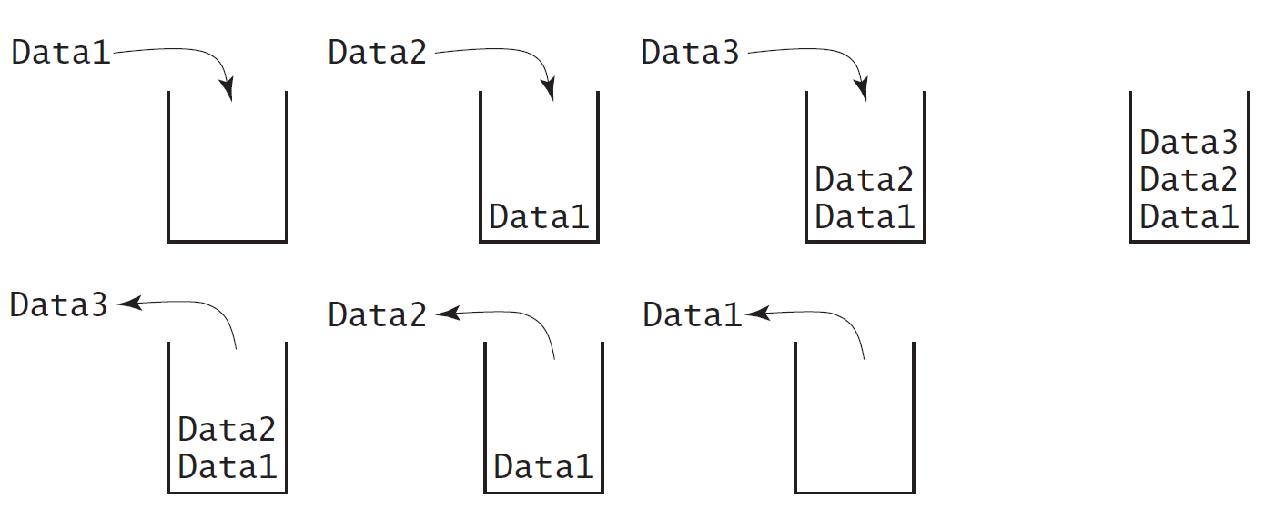
Designing the StackOfIntegers Class

Slide 7
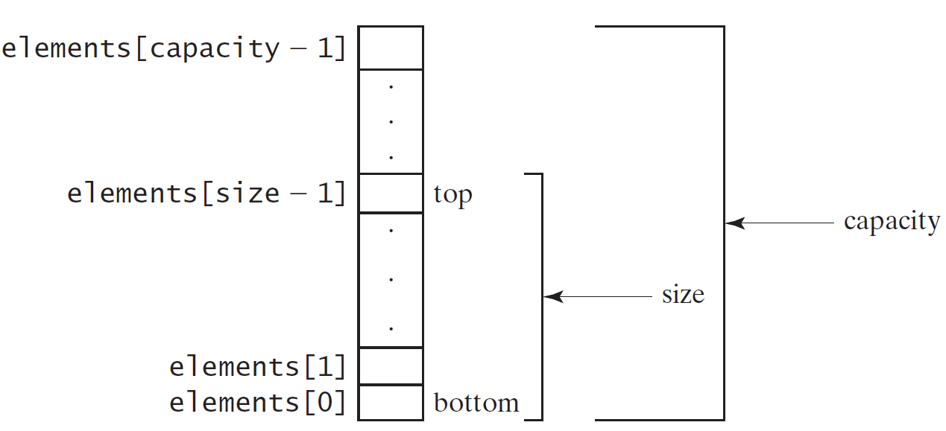
Implementing StackOfIntegers Class
StackOfIntegers

Slide 8
StackOfIntegers Class
Pages 380-1 Listing 10.7
  TestStackOfIntegers.java
Pages 381-2 Listing 10.8
  StackOfIntegers.java

